Slide 1
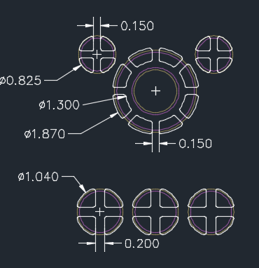
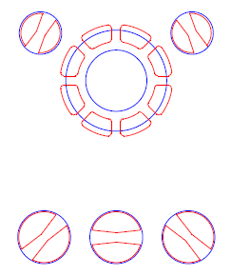
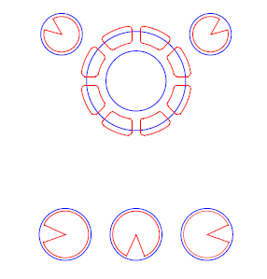
96.1516T00- MIC Solder Void of Control run Report
Improvement plan:
SMT ME consults other BU on the production of similar components. We plan to optimize the stencil aperture as below:
Before:
Current Stencil:
Equally divided into 4 parts
After:
V1: Changed bridge
(Type-1)
After
V2: Sector aperture
(Type-2)
Summary: FII ME will base on the change of aperture on the stencil to conduct a test on the actual MO on the lines.

Slide 2
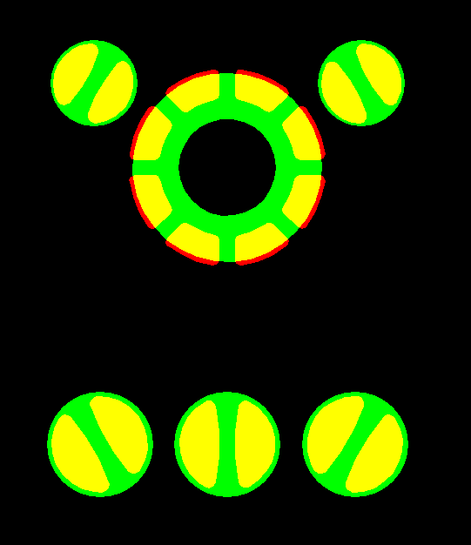
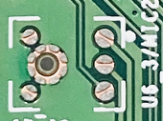
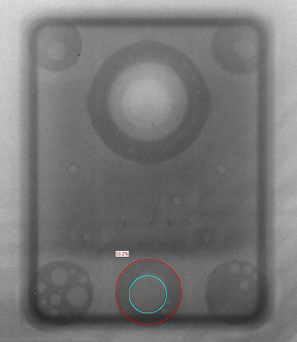
96.1516T00- MIC Solder Void of Control run Report
I. Verify stencil aperture (Type-1)
X-Ray Image confirm.
Profile Feature | Result
Ramp-up rate | 1.05~1.06
Preheat Time (150-180°C) | 80~84
Soldering time (TL>217°C) | 74~75
Peak Temperature (Tp) | 247.3~248.0
Time within 5°C of actual peak temperature (tp) | 27~29
Ramp-down rate | -1.26 ~ -1.22
Defect Type | 1
Solder Void Image (>30%)
% Solder Void | 33.2%
Profile testing
Stencil improved
Type-1
Checking Solder Void
Status | Customer's request Profile (50pcs) Type-1
 | Fail Q'Ty | Total | Defect rate
Void solder <25% | 195 | 200 | 98.00%
Void solder 25%~30% | 4 | 200 | 2.00%
Void solder >30% | 1 | 200 | 0.50%
Verify of result: Check solder void with by X-ray machine:
+ Solder void <25% with defect rate ( 195/200= 98.00% )
+ Solder void 25%-30% with defect rate (4/200=2.00%)
+ Solder void >30% with defect rate ( 1/200= 0.50% )
Summary:
The defect generated by solder void still accounts for 0.5%.
(Specification control <30%)
The solder void percentage is less than 35%.

Slide 3
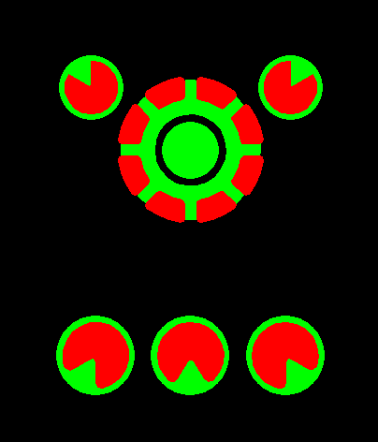
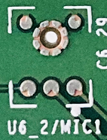
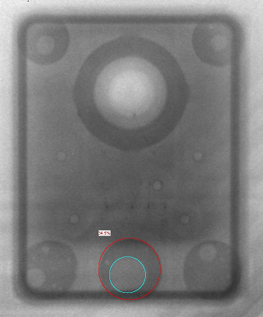
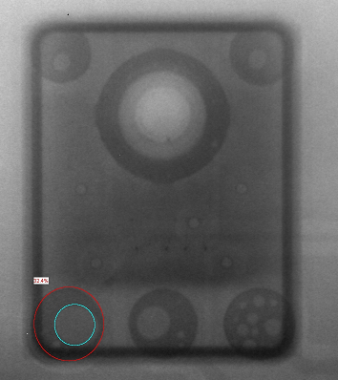
96.1516T00- MIC Solder Void of Control run Report
II. Verify Stencil aperture (Type-2)
X-Ray Image confirm.
Profile Feature | Result
Ramp-up rate | 1.05~1.06
Preheat Time (150-180°C) | 80~84
Soldering time (TL>217°C) | 74~75
Peak Temperature (Tp) | 247.3~248.0
Time within 5°C of actual peak temperature (tp) | 27~29
Ramp-down rate | -1.26 ~ -1.22
Defect Type | 1 | 2
Solder Void Image (>30%)
% Solder Void | 34.5% | 32.4%
Profile testing
Stencil improved
Type-2
Checking Solder Void
Status | Customer's request Profile (50pcs) Type-2
 | Fail Q'Ty | Total | Defect rate
Void solder <25% | 193 | 200 | 97.00%
Void solder 25%~30% | 5 | 200 | 2.50%
Void solder >30% | 2 | 200 | 1.00%
Verify of result : Check solder void with by X-ray machine:
+ Solder void <25% with defect rate ( 193/200= 97.00% )
+ Solder void 25%-30% with defect rate (5/200=2.50%)
+ Solder void >30% with defect rate ( 2/200= 1.00% )
Summary:
The defect generated by solder void still accounts for 1.0 %
(Specification control <30%)
The solder void percentage is less than 35%.

